Slide 1


MIT-113
COMPUTATIONAL FLUID DYNAMICS
LID DRIVEN CAVITY Project Presentation
Presented By:
Apoorv Bhardwaj - 23117026
Atharv Priyadarshi - 23117034

Slide 2

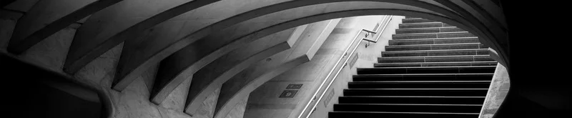
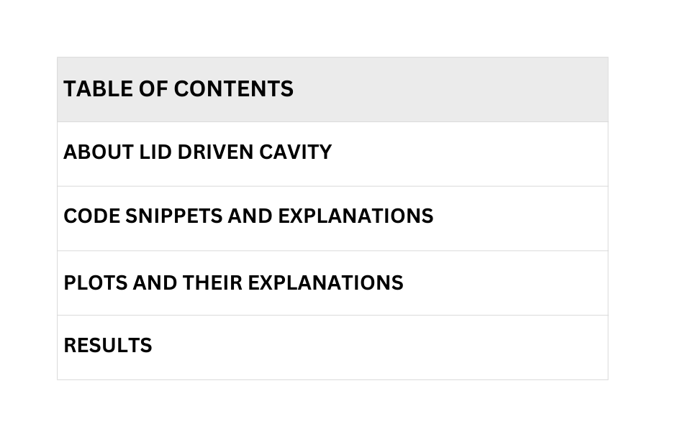
Solving Lid Driven Cavity Problem By Vorticity Stream Function Form of Navier Stokes Equation
GITHUB LINK:
https://github.com/atharv-pdarshi/Lid_driven_cavity_problem.git

Slide 3
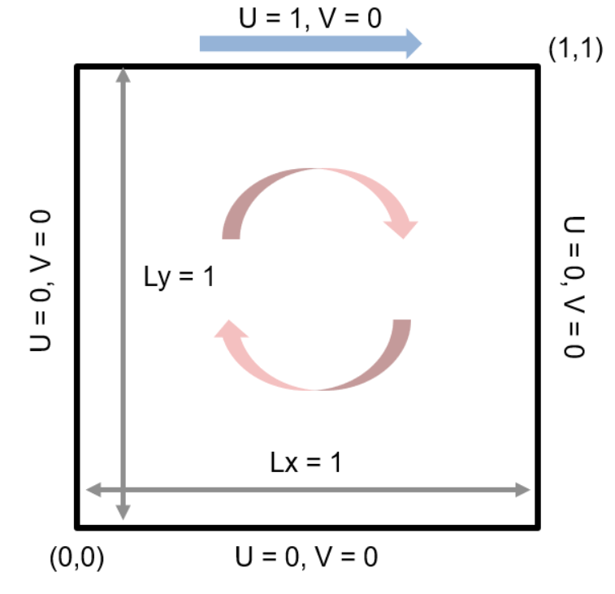
About the
Lid Driven Cavity
The lid-driven cavity problem, a standard CFD benchmark, simulates viscous, incompressible fluid flow within a square cavity driven solely by a moving lid. Varying Reynolds numbers yield diverse flow patterns, from smooth laminar flow to complex vortex structures. Finite difference methods and the vorticity-streamfunction formulation are commonly used for numerical solutions. Key results visualized include velocity profiles, vorticity contours, and streamlines. This problem serves as a valuable test case for evaluating numerical methods and understanding flow behavior in confined geometries.

Slide 4
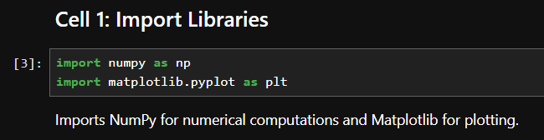
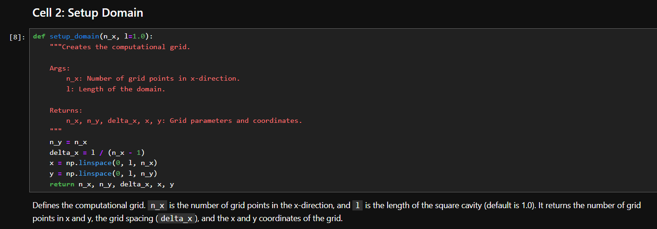
Code And its Explaination

Slide 5
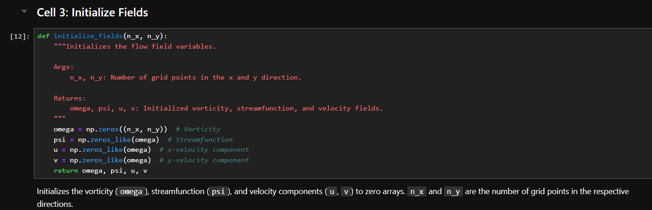

Slide 6
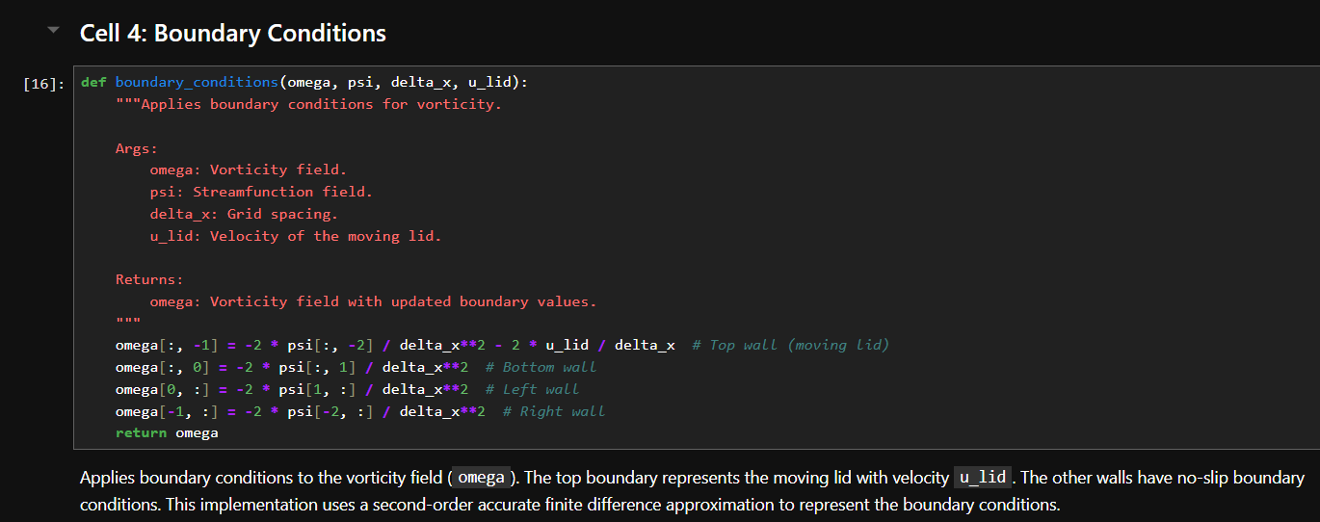

Slide 7
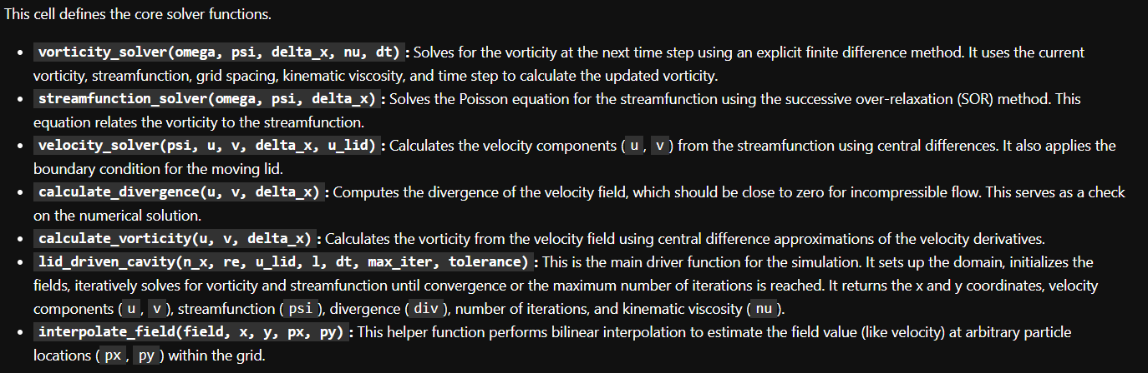

Slide 8
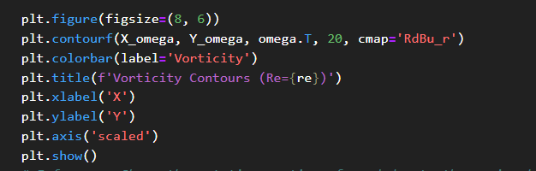
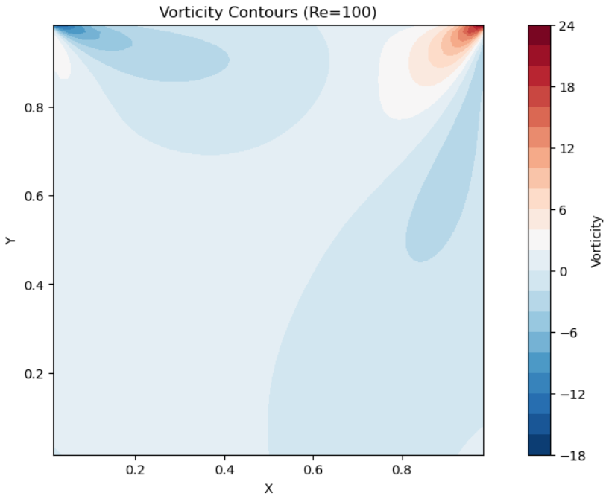
Code snippets for plots and their summaries
This graph depicts the distribution of local fluid rotation within a square domain for a flow at a Reynolds number of 100. It clearly shows a primary vortex with positive vorticity in the top-right corner and weaker, secondary eddies with negative vorticity developing in the bottom-right and top-left corners. A much weaker, or nascent, eddy might be present in the bottom-left. The center of the domain experiences very little rotation.

Slide 9
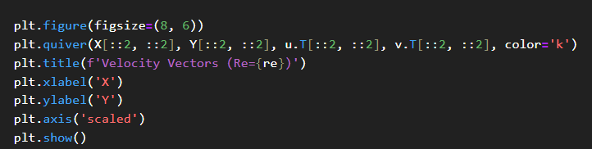
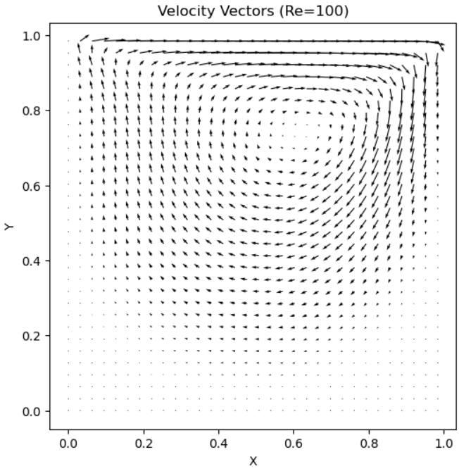

Slide 10
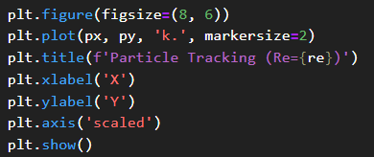
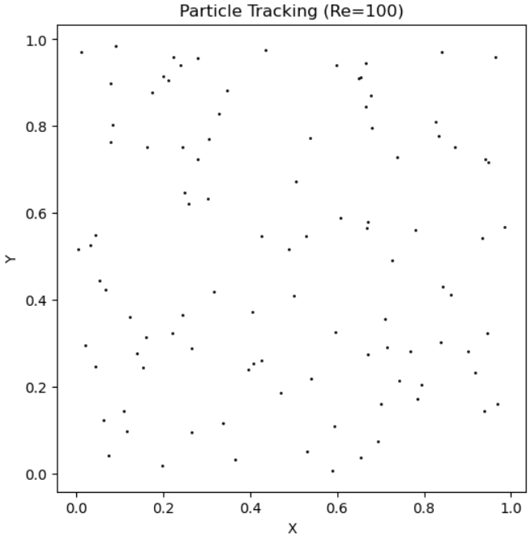
This plot shows the spatial positions of multiple individual tracer particles within the Re=100 flow field at a single moment. Most probably, it depicts the initial random or uniform seeding of these particles before they are set in motion by the fluid.

Slide 11
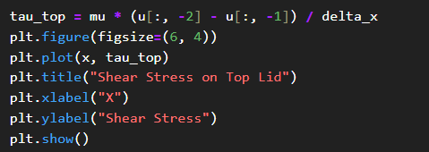
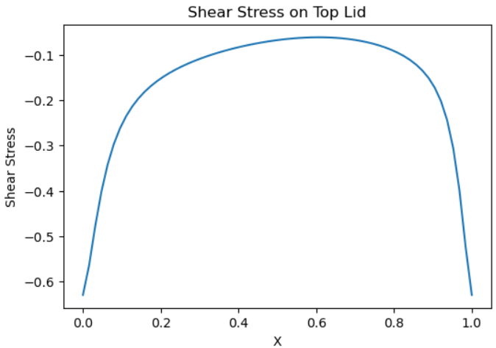
The stress is highest (in magnitude) at the corners where the moving lid meets the stationary side walls due to sharp velocity gradients.
The stress is lowest (in magnitude) towards the middle of the lid.
The negative values indicate that the force opposes the lid's motion.

Slide 12
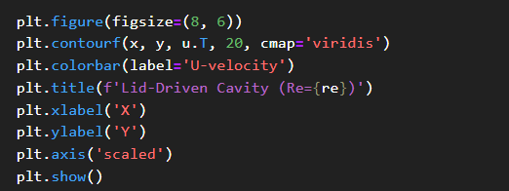
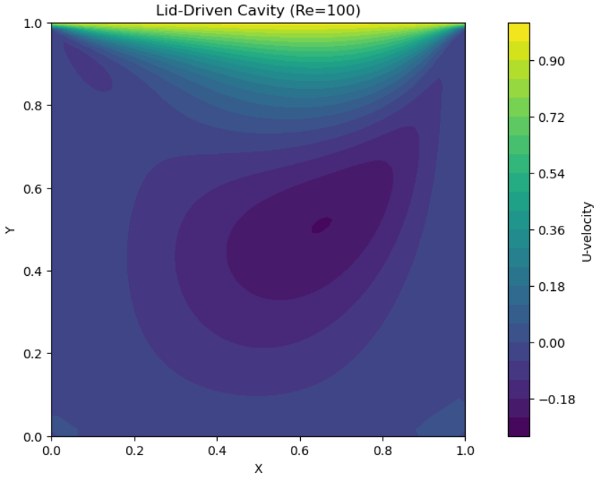
High positive U-velocity (rightward flow) is seen at the top, driven by the lid.
Significant negative U-velocity (leftward flow) is seen in the lower part, representing the return flow of the main vortex.
Regions of near-zero U-velocity are found along the vertical walls and in the areas where the flow is primarily vertical or transitioning between rightward and leftward motion.

Slide 13
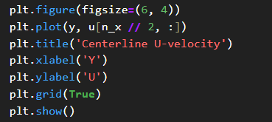
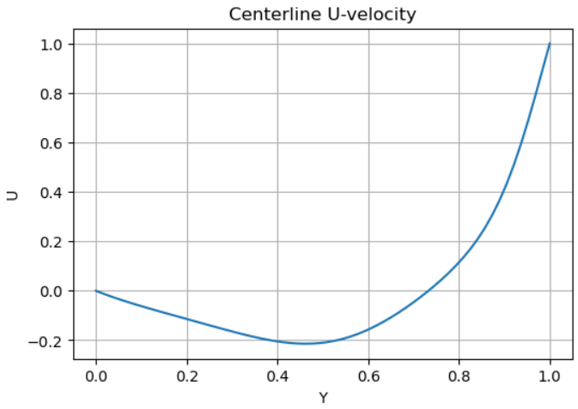
Zero horizontal velocity at the bottom stationary wall.
A region of leftward flow in the lower part of the cavity.
A point where the horizontal flow reverses direction (near the center of the primary vortex).
A region of rightward flow in the upper part, culminating in the lid's velocity at the very top

Slide 14
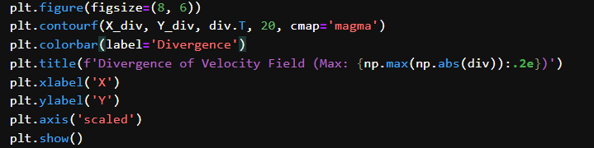
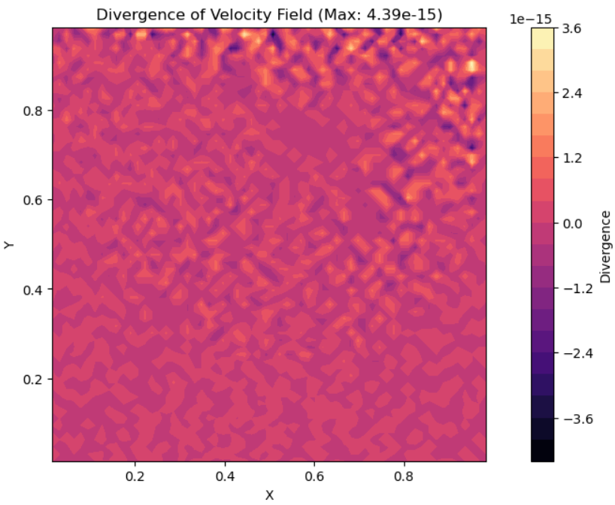
It demonstrates that the incompressibility condition (∇ ⋅ V = 0), which is fundamental for this type of flow, is being satisfied to a very high degree of numerical precision.

Slide 15
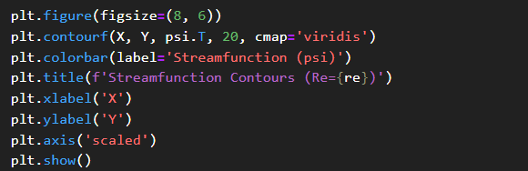
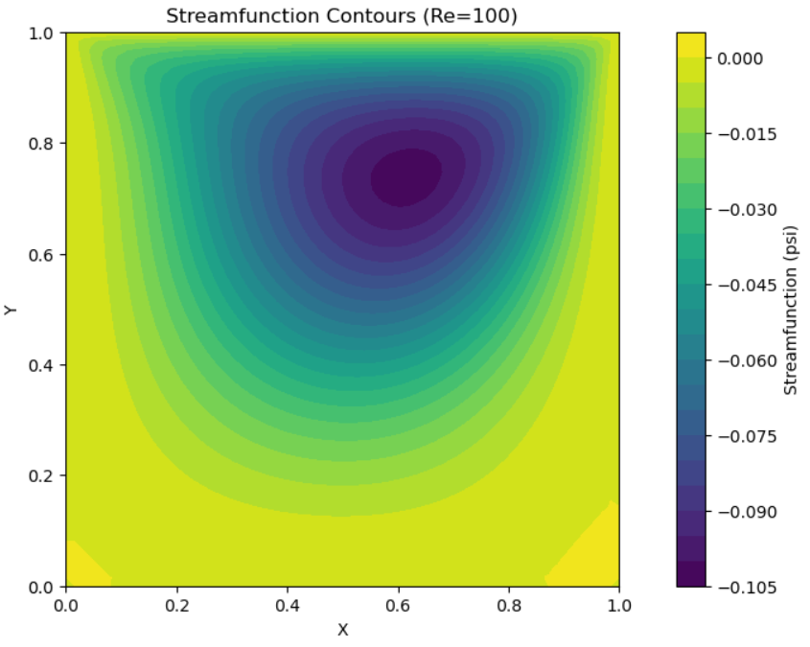
The solid walls are streamlines (ψ=0).
A large, dominant clockwise primary vortex occupies most of the cavity, with its center at the minimum ψ value.
Smaller, counter-clockwise secondary eddies are present in the bottom-right and top-left corners, and a very weak one in the bottom-left.

Slide 16


Validated Solver
The implemented finite difference solver accurately captures the flow dynamics within the lid-driven cavity, showing strong agreement with benchmark data across a range of Reynolds numbers.
Flow Complexity with Reynolds Number
Results
Simulations demonstrated the transition from smooth, laminar flow at low Reynolds numbers to more complex flow patterns, as the Reynolds number increases.
Effective Visualization
Generated visualizations (velocity profiles, vorticity contours, streamlines, etc.) effectively communicate the flow behavior and provide insights into the influence of the moving lid and viscous effects.

Slide 17
THANK YOU

